Slide 1


Project name: Solar Power Battery Team members: Lauren Lugo, Tarik Dawson, Clement Ong, Nathan Gil

Slide 2
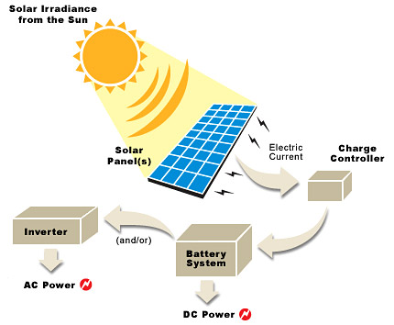
Project description
Problem Statement:
Provide the user with an independent solar power generating system that can charge both AC and DC devices
Solution proposal:
Develop independent power grid using solar panels that can charge the majority of items throughout the day and night

Slide 3
System Overview
Clement
DC Bus
DC-AC Inverter
AC Load
Tarik
Solar Panel
DC-DC Converter
DC Load
Lauren
PWM Generator
Batteries
MPPT Algorithm (MCU)
Voltage Regulation
Nathan
Computer Application
Phone Application

Slide 4
MPPT Subsystem
Voltage and Current Sensor
Accomplishments since the last Presentation 15 Hours | Ongoing progress/problems and plans until the next presentation
Learned basics for ESP32 IDF and C language Actively communicate to microcontroller, receives input and outputs accordingly Finalized communication to DC-DC converter, using a DAC output | Finished ordering parts that were missing/adjustments that needed to be made Testing the breakdown of components individually (current sensor, voltage sensor, gate drivers) Put components together on perfboard
Solar Panel
DC-DC Converter
DC Load
DAC Output
Battery
ESP32
Voltage and Current Sensor
Voltage and Current Sensor

Slide 5
DC-DC converter
Accomplishments since the last presentation 20 hours | Ongoing progress/problems and plans until the next presentation
Finalised DC/DC Design Created and imported footprints for parts Parts Ordered Beginnings of PCB design started | Unable to simulate design on multisim or altium Finalize PCB design Test and validate a breakout board and a final PCB

Slide 6
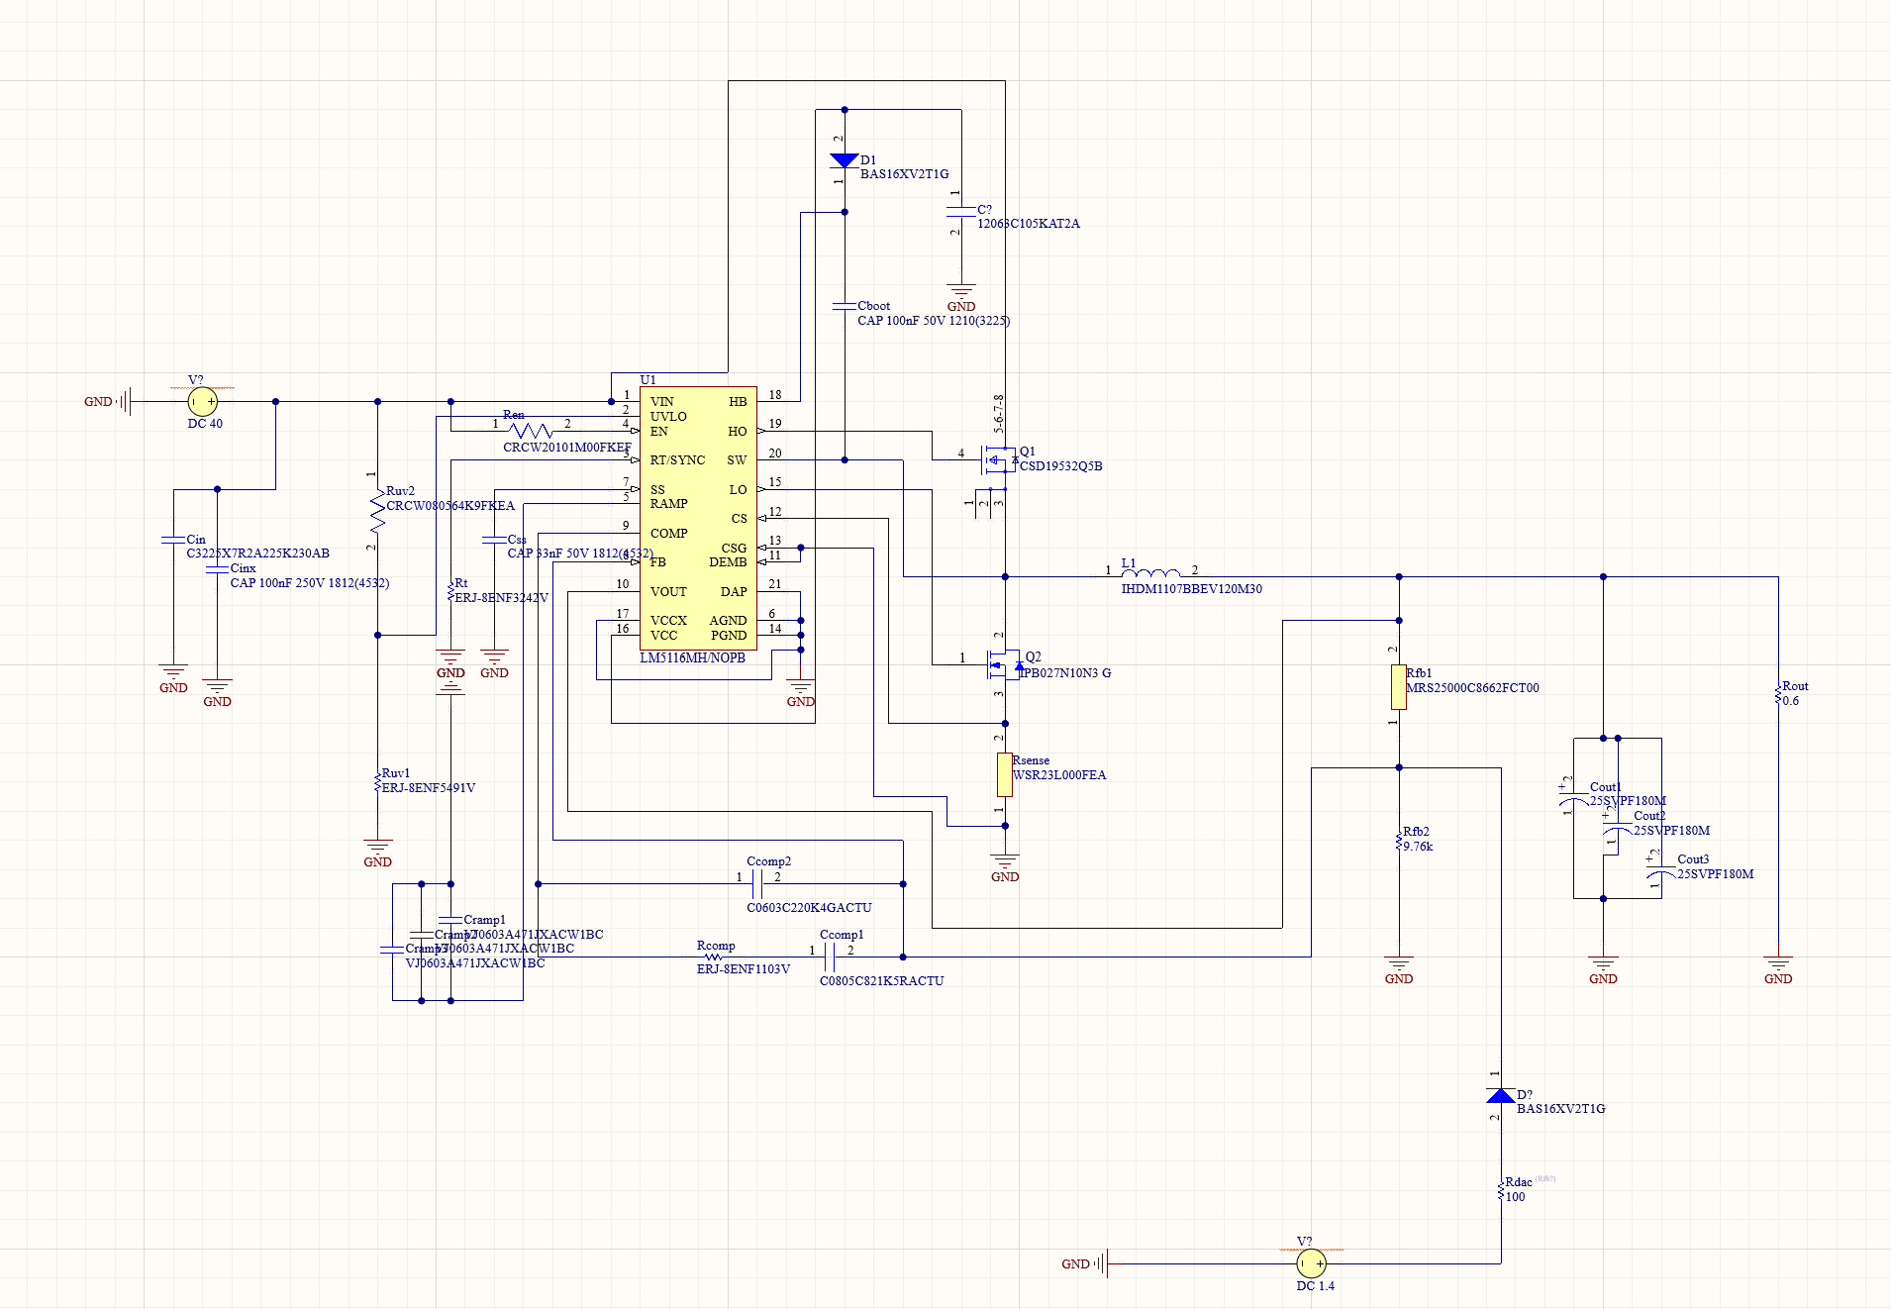
DC/DC converter design

Slide 7
DC-AC Inverter
Accomplishments since the last presentation 20 hours | Ongoing progress/problems and plans until the next presentation
Almost finished designing a working DC-AC inverter that outputs a pure sine wave generating 165V peak-to-peak | H-bridge inverting section of design not producing correct output Increase efficiency Finalize PCB design in Altium Finish breadboarding and testing

Slide 8
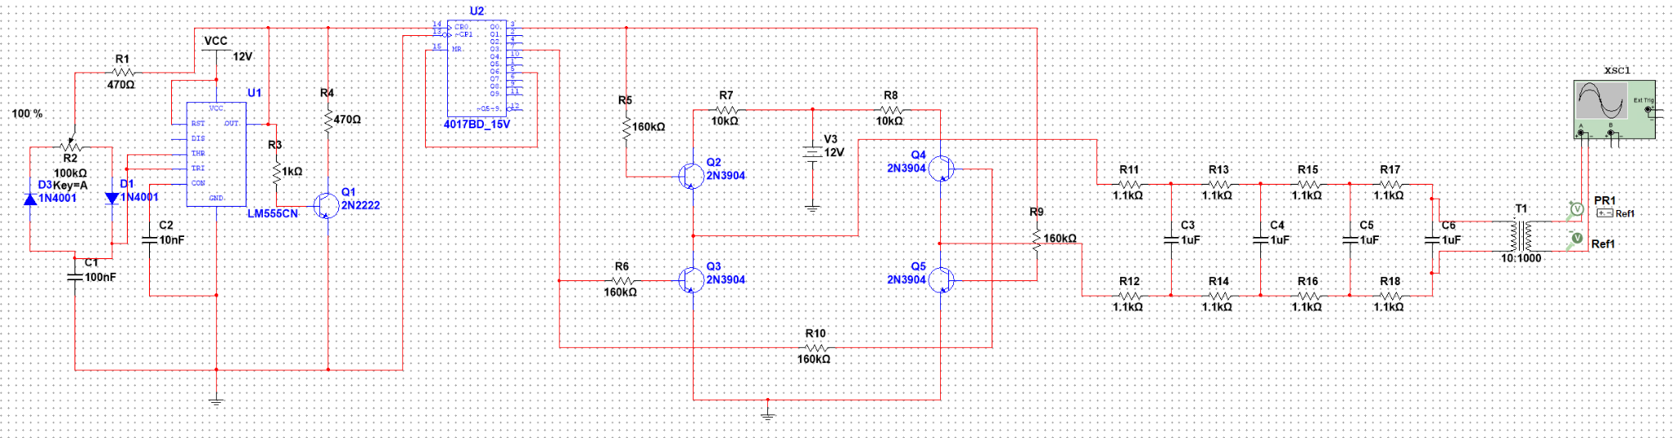
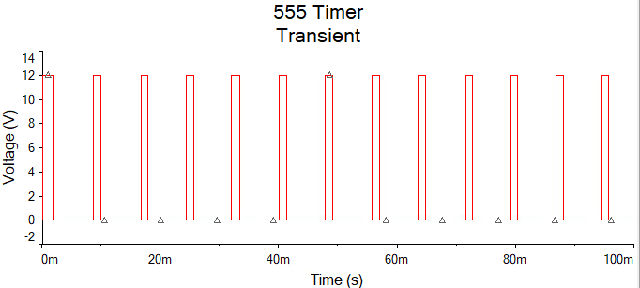
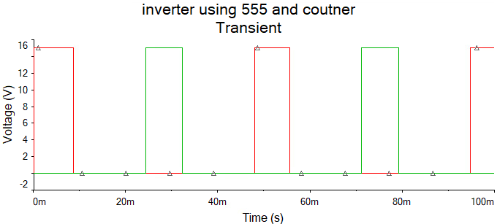
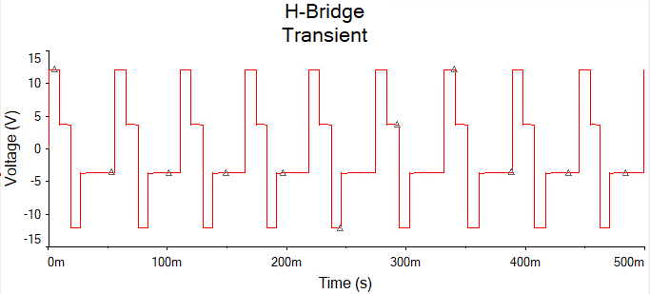
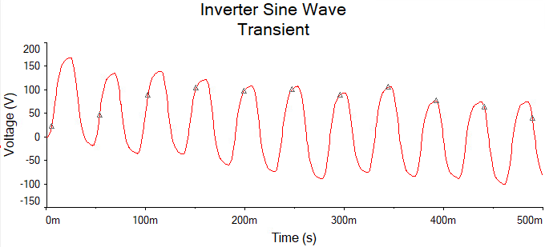

Slide 9
Applications and Website Update
Nathan Gil
Accomplishments since the last presentation 17 Hours | Ongoing progress/problems and plans until the next presentation
Learned Ionic (allows you to code app and website simultaneously) Implemented the Design for the Android Application and Website Created Firebase database/learned best practices for organizing data Working on imitating the ESP32 using a test file to push request to the backend server Working on pulling data from the backend database | Finish pull request for all graphs in App and Website Display the data accurately and make sure its dynamic depending on the data being pulled Have testing done for app and website so that its ready for system data in 404

Slide 10
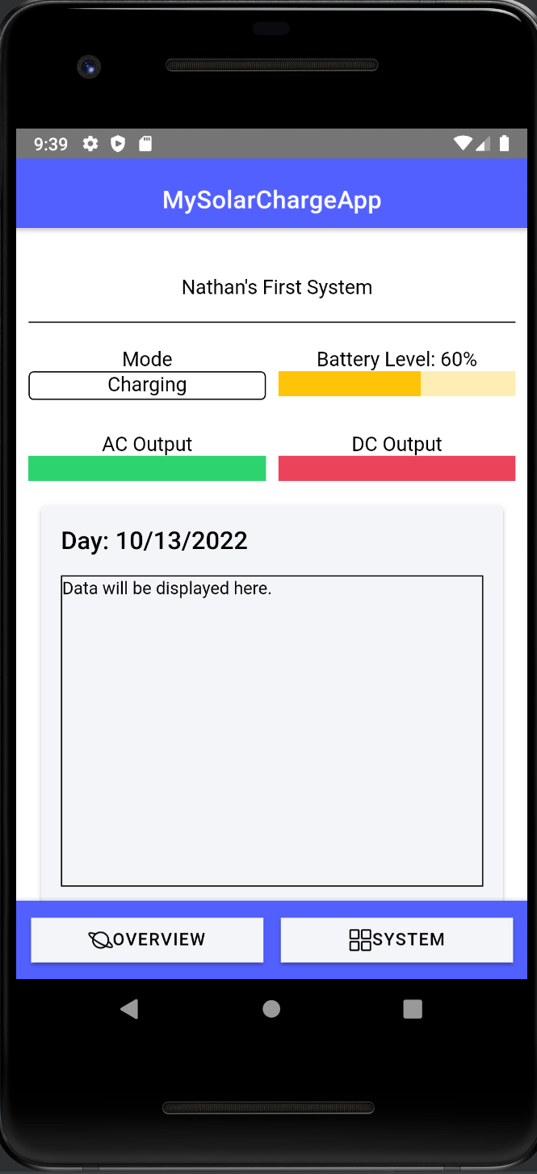
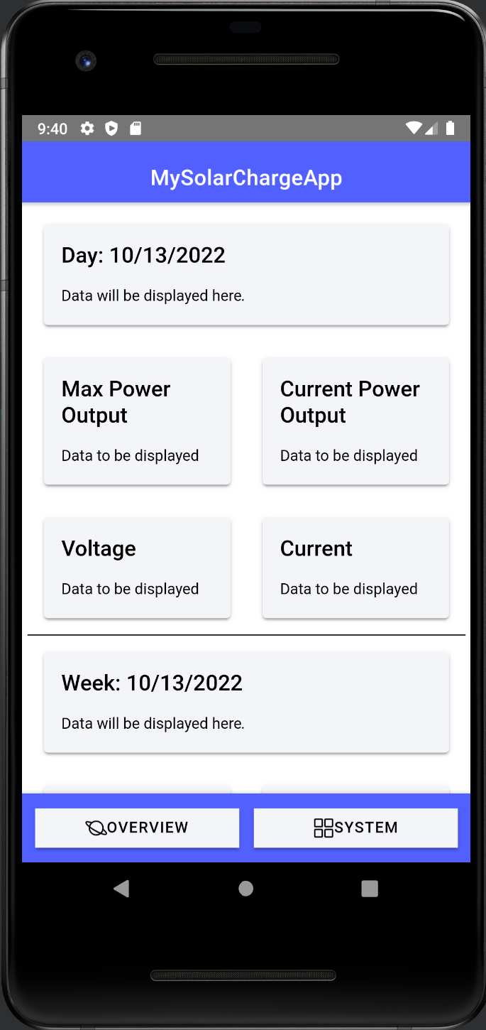
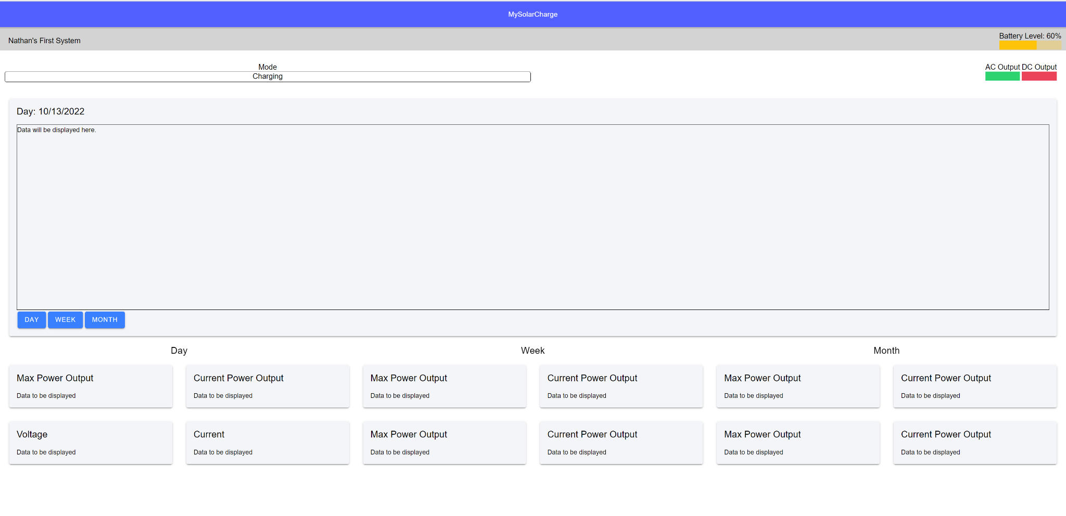
Design(s) Update

Slide 11
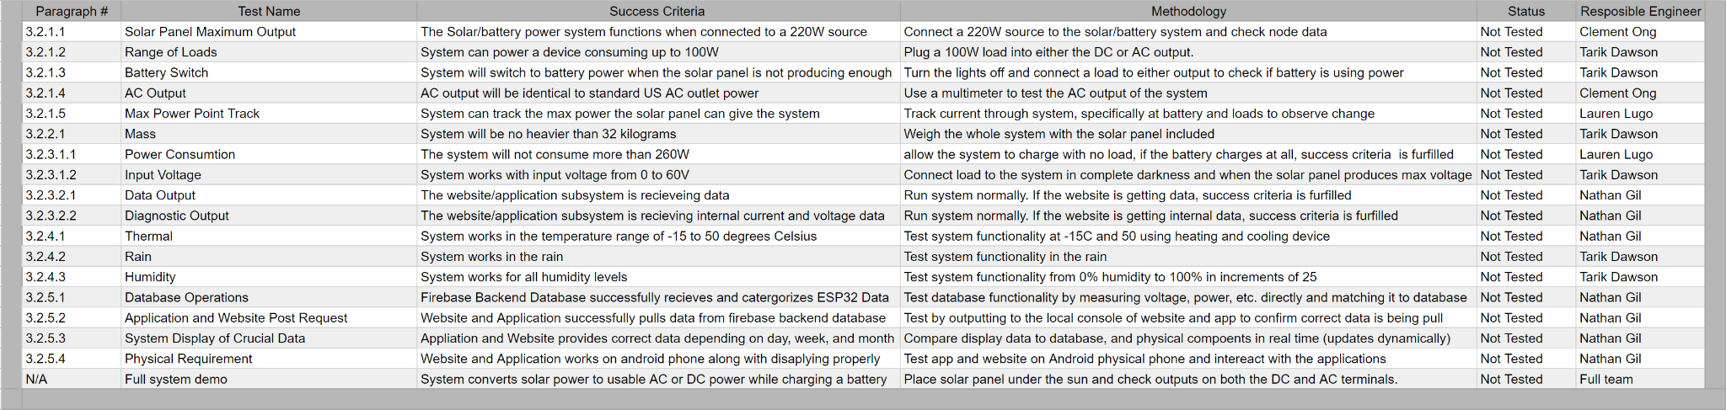
Validation Plan

Slide 12
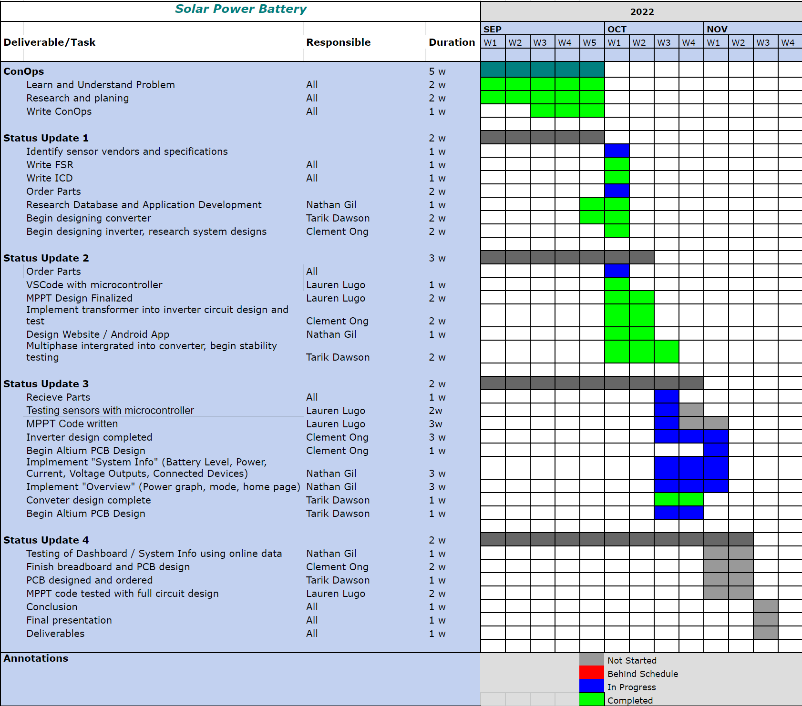
Execution Plan

